Slide 1
How our FOOD changes the WORLD
We Eat responsibly

Slide 2
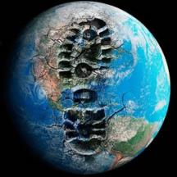
What kind of planet
are we leaving behind
for our children?

Slide 3
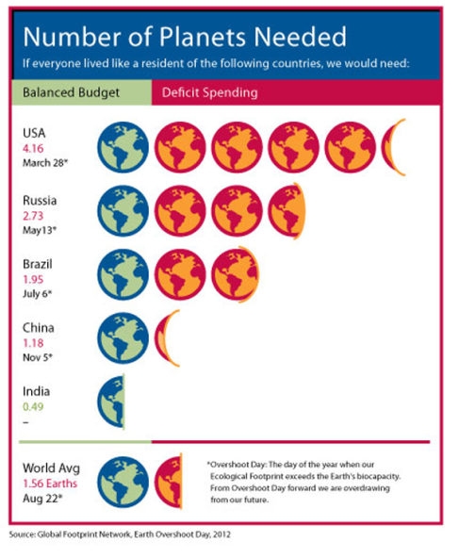
Using more that we are entitled to

Slide 4
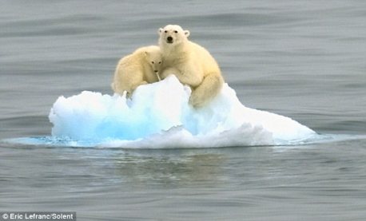
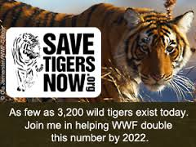
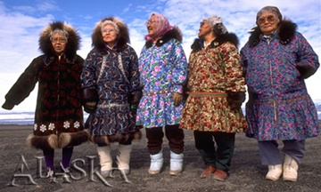
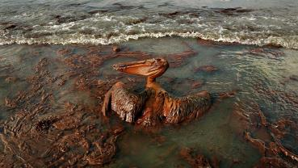
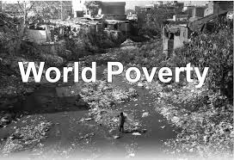
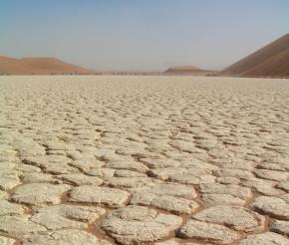

Slide 5
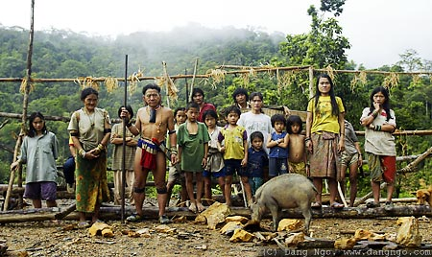
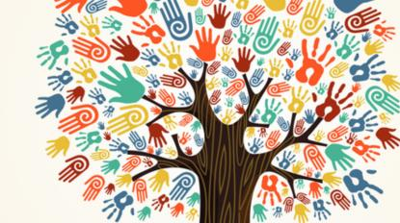
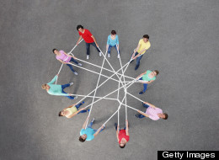
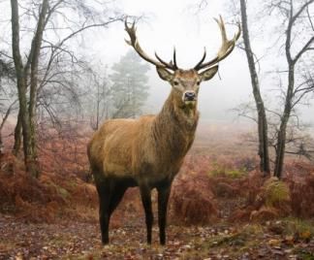
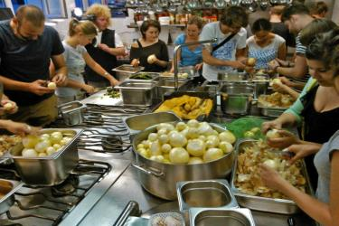
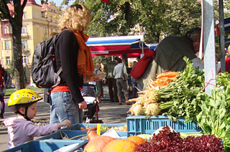

Slide 6
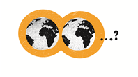
What kind of planet
are we leaving behind
for our children?

Slide 7
What kind of children
are we leaving behind
for our planet?

Slide 8
Us, our lifestyles and the world

Slide 12
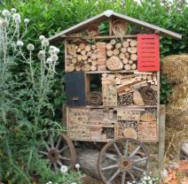
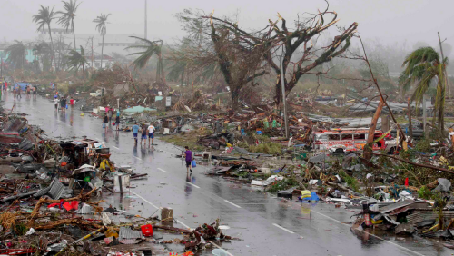

Slide 13
Notes:
We need a transition towards sustainable lifestyles, and stronger systemic changes

Slide 14
What if
there was an important part of our everyday life that played a crucial role in addressing global challenges?
and that this part was largely underestimated?

Slide 15
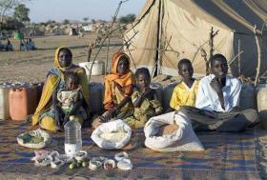
Food is at the center of global challenges

Slide 16
Food is at the center of global challenges

Slide 18
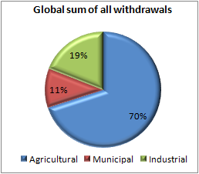
Source: FAO-Aquastat

Slide 22
Use of resources (WEL nexus)
Water
Land
Energy

Slide 23
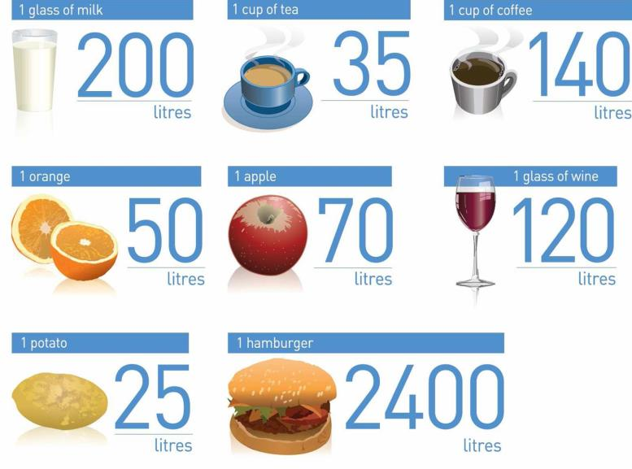
Hidden water

Slide 24
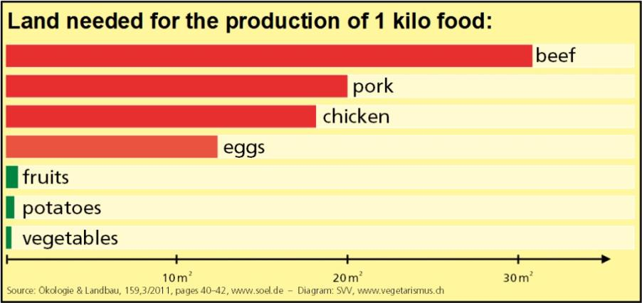
Hidden Land

Slide 25
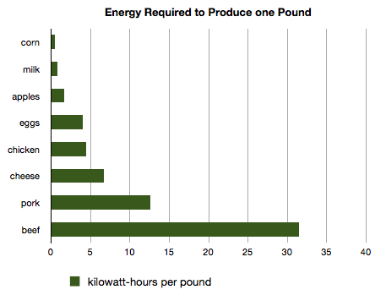
Hidden Energy

Slide 26
Connecting the WEL Nexus to food production and consumption
Some foods are more resource-intensive than others.
The actual amount of hidden resources depends on:
methods of production
processing
distance between where it is produced and where it is consumed

Slide 27
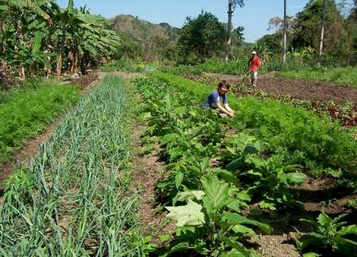
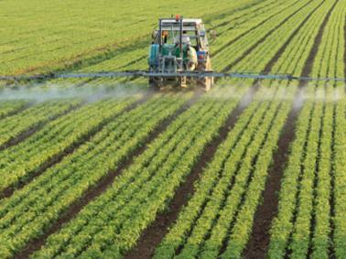
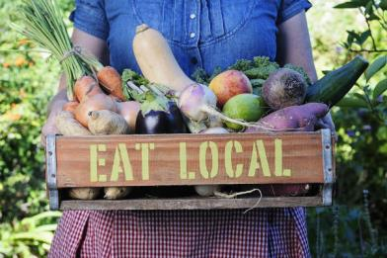
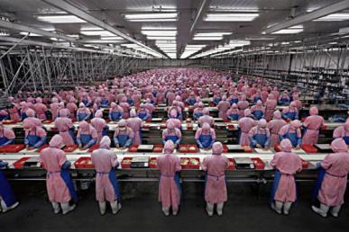
Methods vary widely

Slide 30
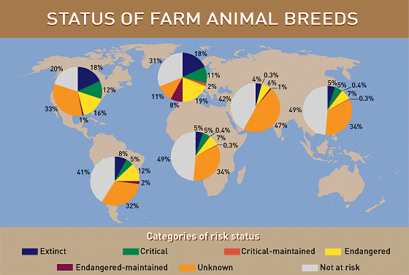

Slide 31
Food is at the center of global challenges

Slide 32
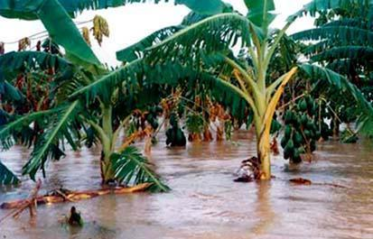
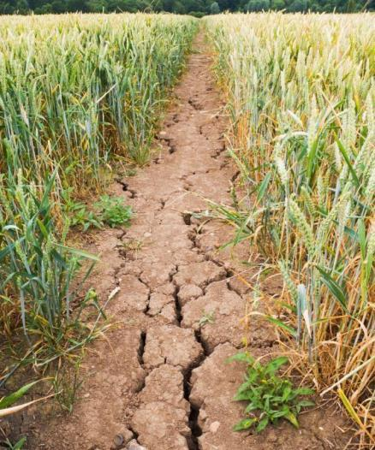
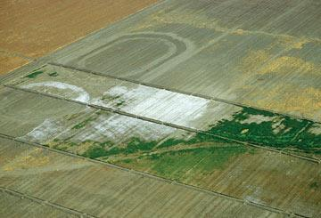

Slide 33
Highly interconnected
Food production
Climate change

Slide 34
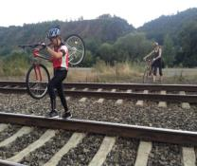

Slide 35
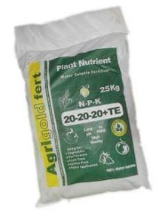
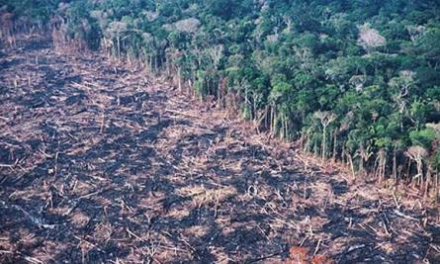
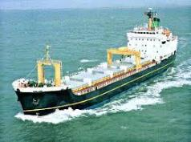
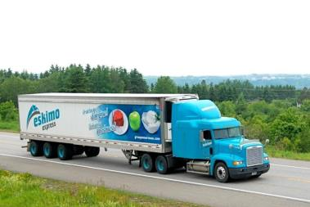
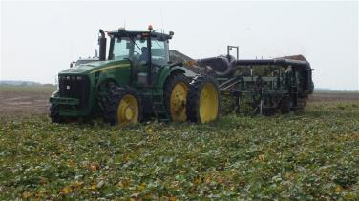
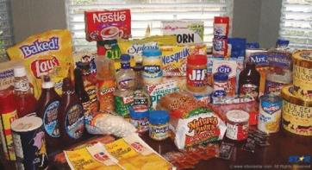

Slide 36
Food is at the center of global challenges

Slide 37
40% of the world population works in agriculture

Slide 38
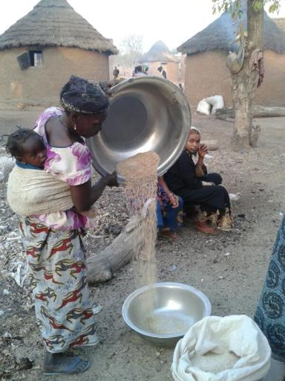
Smallholder farmers
produce nearly 75 %
of the food consumed
worldwide.

Slide 39
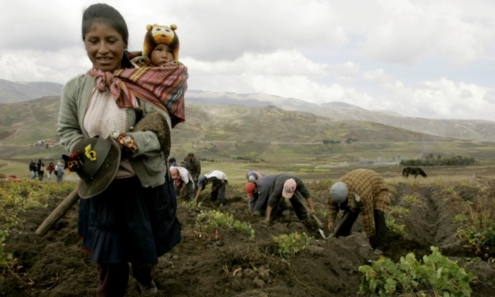

Slide 40
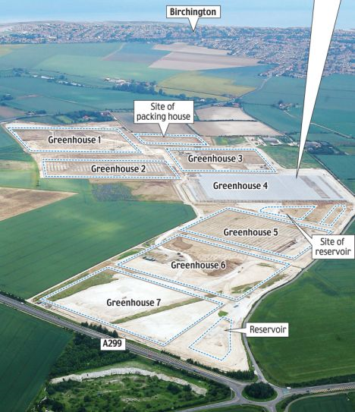
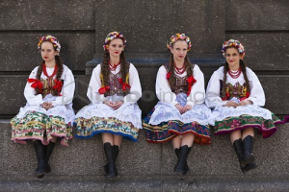
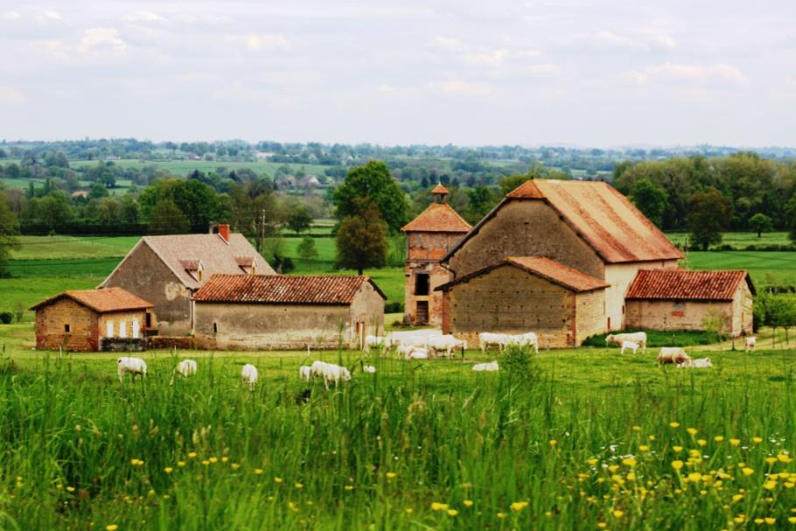

Slide 41
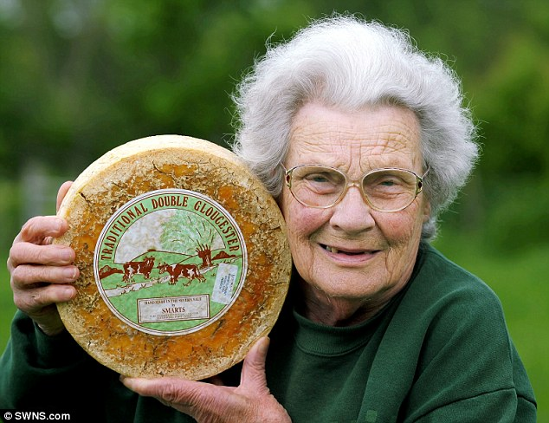

Slide 42
Food is at the center of global challenges

Slide 43
795.000.000

Slide 44
Who are the hungry?

Slide 45
795.000.000
1.900.000.000
42 million children under the age of 5 were overweight or obese in 2013

Slide 46
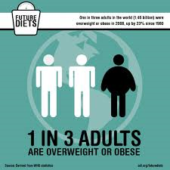

Slide 47
What is food security?
“when all people, at all times, have physical and
economic access to sufficient, safe, nutritious food to meet their dietary needs and food preferences for an active and healthy life“
World Food Summit, 1996

Slide 49
9 billion health
nutrition
cutting our depedance on fossil fuels
climate
Rural services carbon sequestration
protection of soil and water
Small scale farmers biodiversity
Women empowerment

Slide 50
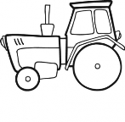
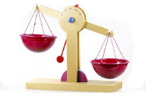
What is food security?
“when all people, at all times, have physical and
economic access to sufficient, safe, nutritious food to meet their dietary needs and food preferences for an active and healthy life“
World Food Summit, 1996

Slide 51
What kind of children
are we leaving behind
for our planet?

Slide 53
QUIZ
1/ Based on the world food trade data, can we say that
A) The EU27 countries feed developing countries
B) Developing countries feed the EU27 countries

Slide 54
Who is feeding whom?
20% of the world population uses 40 % grain & 40 % animal protein (meat, fish, dairy products) of the world’s production

Slide 55
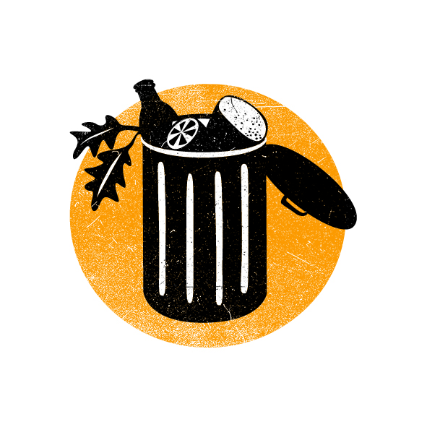
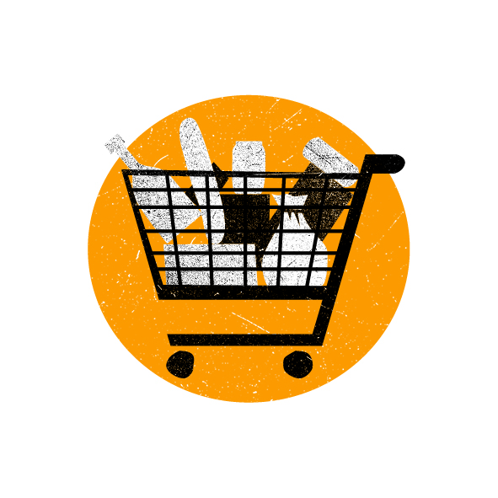
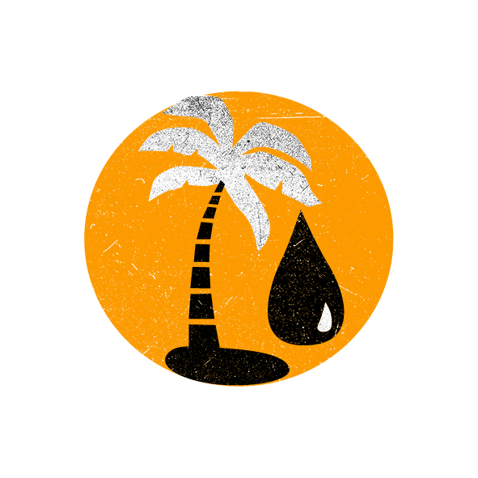
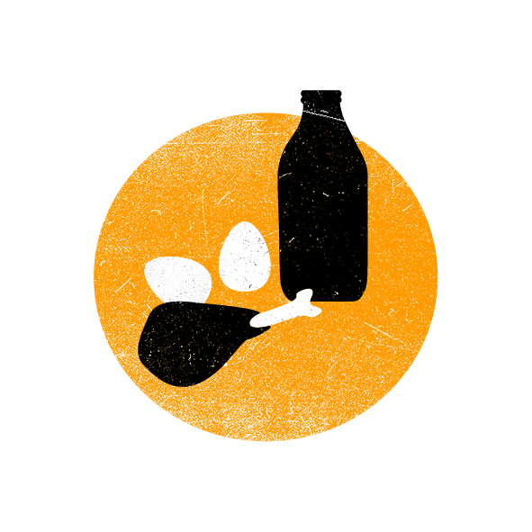
How our food changes the world?

Slide 56
"World map of Energy consumption 2001-2003" by Lokal_Profil.

Slide 57
Big portions

Slide 58
Big portions
Across the world, the average caloric intake varies widely.
2,120 kcal in least developed countries,
2,640 kcal in developing countries
3,430kcal per person in developed countries.
Do you know that Czech Republic is rated among the highest food consumption level in the world and that a Czech person eats 3320 kcal per day in average?

Slide 59
795.000.000
1.900.000.000
42 million children under the age of 5 were overweight or obese in 2013

Slide 60
Too much meat & dairy products

Slide 61
Worldwide, our diets countain more meat
And less and less cereals, potatoes and pulses

Slide 62
QUIZ
2/What is the Slovenian average consumption of meat per person per year?
33kg
67kg
82kg

Slide 63
QUIZ
3/What is the world average consumption of meat per person in India?
5, 2kg
18,2kg
28,2kg

Slide 65
4/ With a field of one hectare, how many people will I feed for a year if I produce lamb or beef?
Around 1 person
Around 3 people
Around 6 people

Slide 66
5/ With a field of one hectare of potatoes, how many people can I feed for a year?
Around 10 people
Around 20 people
Around 30 people

Slide 69
+

Slide 70
Too much meat and dairy products
Once a week or more could we replace meat with grains, legumes & vegetables?
And choose meat which doesn’t come from intensive farming?

Slide 71
Space and time gaps in our food

Slide 72
QUIZ
6/ When is the harvesting season for eggplant in Slovenia?

Slide 73
7/ Which of the following accounts for the largest portion of a food item´s carbon footprint ?
Production and processing
Packaging
Transportation

Slide 75
Case of Asparagus in Peru

Slide 76
Space and time gaps in our food
Are imports from the south beneficial for people?
What about wages?
What about model of development?
What about resources?

Slide 77
Space and time gaps in our food
Do we know the actual seasons of fruit & vegetable types?
Do we consider if our food is produced with a minimal impact on people & natural resources?
Do we know that methods of production has bigger impact than food miles?

Slide 80
More processed food

Slide 81
8/ What is the percentage of processed food products containing palm oil?
20 percent
50 percent
80 percent

Slide 82
9/ The total land needed for palm oil production in the world represents
1 time Slovenia
3 times Slovenia
6 times Slovenia

Slide 83
More processed food
Palm oil is
the most used vegetable oil in Europe
in 2000, most traded vegetable oil in the world
used in 50% of processed foods, cosmetics, detergents, animal feed and fuel
Only 15% of palm oil is certified

Slide 85
More processed food
Do we know about palm oil? Do we
consciously look for products that don’t contain palm oil?
If we see that our favorite products use palm oil, we can write to their producers to urge them to change recipe, or to use palm oil with the highest standard of certification.

Slide 86
Huge food wastage

Slide 87
10/ How much food is wasted in the world?
One fifth all food produced
One third of food produced
One half of food produced

Slide 88
11/ If I don t finish my hamburger and throw a third of it, how much water do I waste?
600 liters
700 liters
800 liters

Slide 89
Food waste
Facts
One third of the world’s food is wasted.
In developing countries: 6–11 kg a person
Industrialized countries: 95–115 kg

Slide 91
Food wastage
Do we notice if we waste food?
What strategies do we put in place to diminish food wastage? Do we work with leftovers? Do we ask for doggie bag? Etc.

Slide 92
Loss of varieties

Slide 95
Svalbard Global Seed Vault (Artic)

Slide 96
QUIZ
12/ Out of the 80.000 edible plant species, how many do we cultivate?
150 species
1.500 species
15.000 species

Slide 100
Loss of varieties
Can we sustain the richness of our system of resources by discovering forgotten types of fruits & vegetables?
Do we value variety & encourage farmers to continue to grow?

Slide 101
What’s next?

Slide 102
What kind of children
are we leaving behind
for our planet?

Slide 103
Raising global, responsible and active citizens?

Slide 104
What is responsible food consumption?

Slide 105
Heatlhy diet =
A key feature of a healthy diet is dietary diversity consuming a variety of foods across and within food groups to ensure intake of essential nutrients. Fruits, vegetables, quality carbohydrates, nuts, fish, healthy vegetable oils and modest amounts of dairy products are emphasized. Sugar, trans fats, processed meats and foods should be limited.
(Nugent et al., 2011)

Slide 106
Sustainability =
Sustainability implies a state where the needs of the present and local population can be met without diminishing the ability of future generations or populations in other locations to meet their needs or without causing them harm to environment and natural assets.
(Foresight, 2010)

Slide 107
Sustainable diet =
Sustainable Diets are those diets with low environmental impacts which contribute to food and nutrition security and to healthy life for present and future generations. Sustainable diets are protective and respectful of biodiversity and ecosystems, culturally acceptable, accessible, economically fair and affordable; nutritionally adequate, safe and healthy; while optimizing natural and human resources.
(FAO/Bioversity International, 2012)

Slide 108
Responsible diet =
„Consumption is responsible when it takes into account its impact on the quality of human life in its every dimension: health, natural resource management, the economy, spatial planning, the environment, the fight against poverty and social exclusion, social life, culture, etc.“
Council of Europe, 2006

Slide 109
Guiding questions of a responsible food consumer
HOW MUCH do I eat?
HOW MUCH do I waste?
WHAT do I eat?
HOW was my food produced?
WHERE does my food come from?

Slide 110
Thank you for your attention
destree@glopolis.org
cajkova@glopolis.org

